Slide 1
Animation
Lesson 1.5

Slide 2
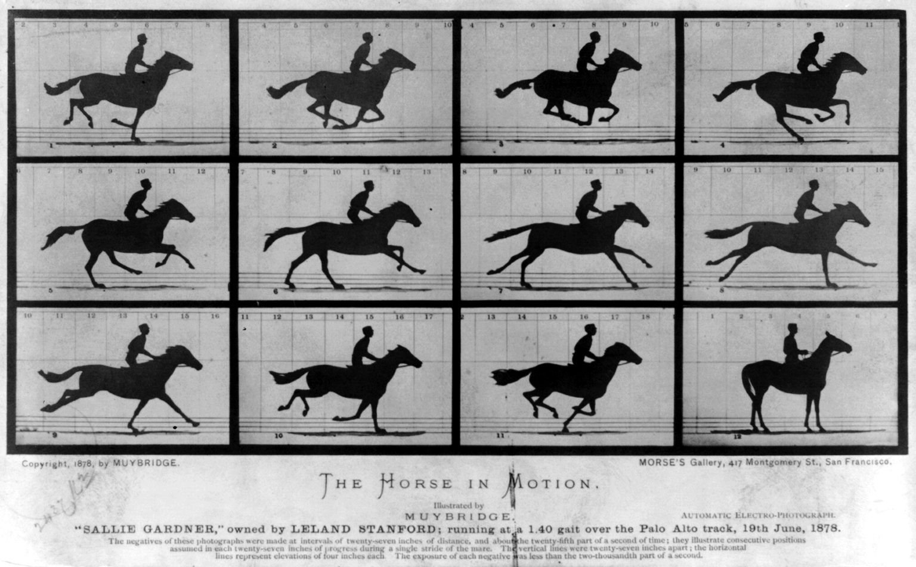
Frame, frame, frame, …
[Source: Wikipedia]
Eadweard Muybridge

Slide 3
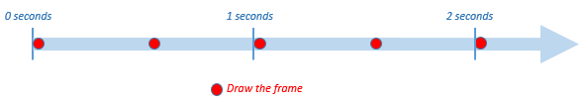
When do we draw?
Two frames per second

Slide 4
Drawing each frame…
function drawFrame() { var canvas = document.getElementById("mainCanvas"); var context = canvas.getContext("2d"); context.fillRect(0, 0, 10, 10); } function start() { var framesPerSecond = 2; setInterval(drawFrame, 1000 / framesPerSecond); }

Slide 5
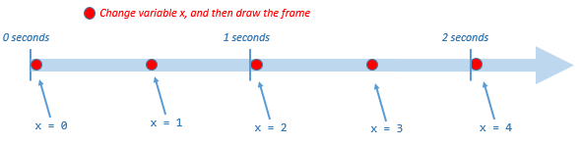
Adding movement…
var x = 0;
function drawFrame() {
var canvas = document.getElementById("mainCanvas");
var context = canvas.getContext("2d");
context.fillRect(x, 0, 10, 10);
x = x + 1; } function start() { var framesPerSecond = 2; setInterval(drawFrame, 1000 / framesPerSecond); }

